Slide 1
Free-form Friday –
Putting Tests on the Learn Center
Notes:
Hello and welcome to Free-form Friday. My name is Amy Foster and I’ll be going over how to put tests in the Learn Center.

Slide 2

Who am I?
Amy Foster
  Online Course Developer
  Sales & Service Readiness
  With IGT since 2001

Slide 3
Agenda
Why do we have tests?
Getting the Questions
Add Questions to the Learn Center
Create an Assessment
Create an Instance
Notes:
Let’s go over our agenda for today. First we’re going to talk about why we have tests – both in general and specifically on the Learn Center. We’ll talk about how to get questions, and adding the questions to the Learn Center. Then we’ll discuss actually putting the test together, which requires you to create an assessment and an instance.

Slide 4
Why do we have tests?
Measure Learning
Required for completion
  Attached to the course
Other types of tests
Notes:
In general, we give tests to measure learning. The main reason we give tests in the Learn Center however is to verify completion of the course.
Most of our courses include a test that is used for completion. Tests are built in the Learn Center and attached to the course. The user must pass the course with a certain score in order to complete the course. For most of our courses, they can take the test as many times as they need to in order to pass it.
You can have tests in the Learn Center that are not attached to the course. For instance, a test might be assigned to a user as part of their development plan to see if they can move to the next level.

Slide 5
Getting the Questions
Course Developer
Department Manager
Live event producer
Notes:
If you are a course developer creating a test for one of your own courses, you’ll create your own questions. If you’re entering a test for someone else, you’ll need to get the questions from them. I usually copy and paste the questions into Notepad and do any editing that’s needed. I do edit for spelling and grammar errors and basic comprehension before entering questions.

Slide 6
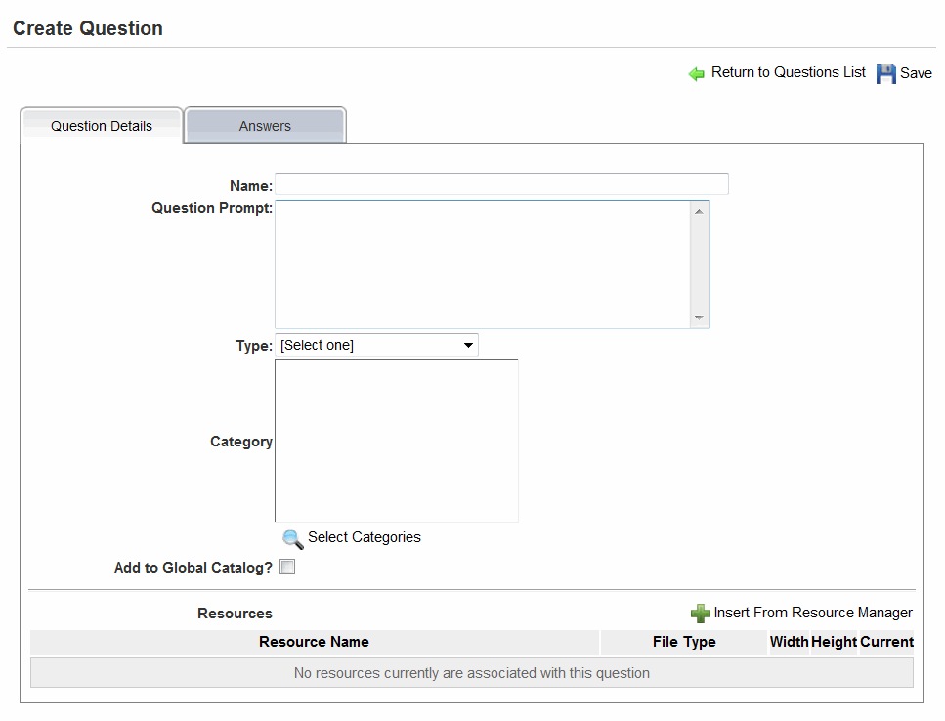
Add Questions
Notes:
I’m going to be app sharing the Learn Center to go through the process of adding questions. Before I do that, I’m going to send out the handout we have on entering assessments. It has a lot of pictures in it, so don’t get put off by the size of it. Since the Learn Center has a lot of pop-up windows, I’m going to be sharing my desktop. {App share will be based on handout – no script}

Slide 7
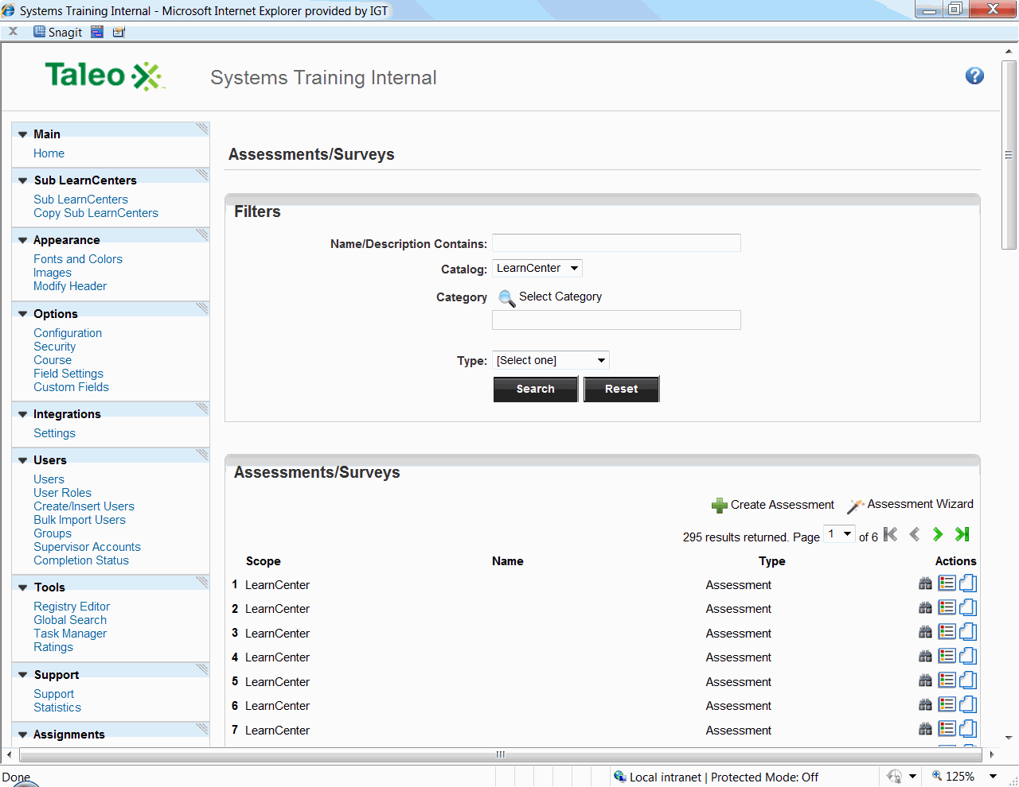
Create an Assessment
Notes:
Once you’ve added question, you can create the assessment. The assessment is basically the group of questions that are going to be asked to the user. At this point, it is just a set of questions, it’s not attached to a course or available to a user. {App share}

Slide 8
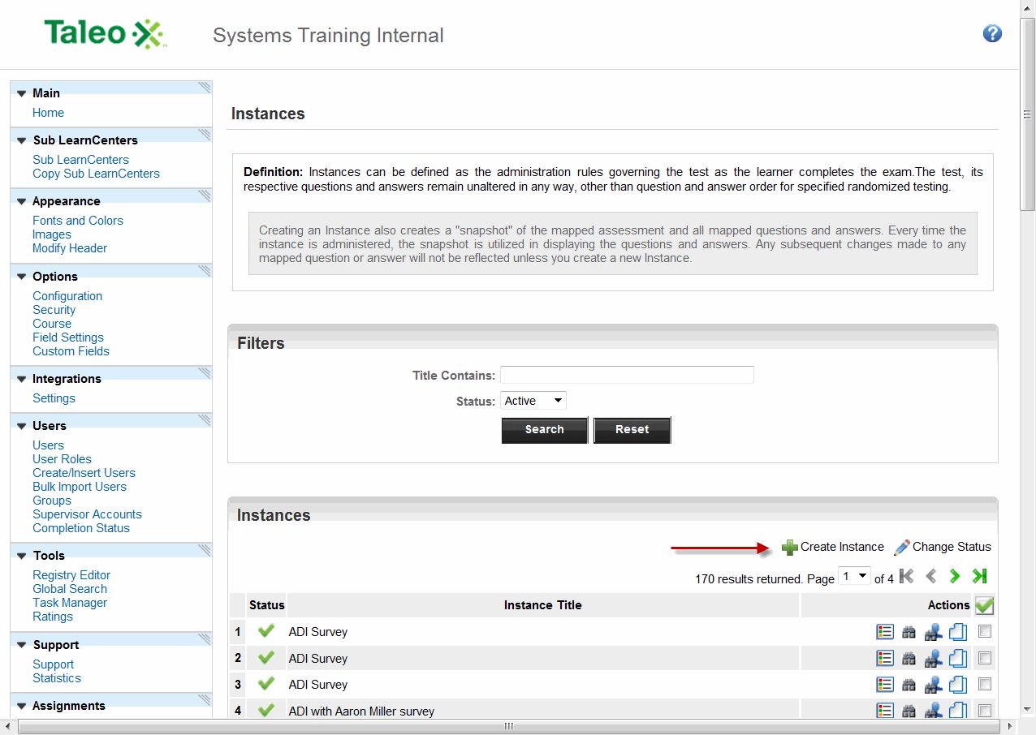
Create an Instance
Notes:
Once you have the assessment, you can create the instance. The instance is what makes the assessment actually viewable to the user. This is where you set how the test is available and various other settings on how it’s actually viewed by the user. Once an instance is setup, any changes you make to the questions or the assessment will not be reflected in the instance. If you need to make any changes (for instance, correct a typo, or add a question to the assessment) you will need to create a new instance. {App share}

Slide 9
Summary
Why do we have tests?
Getting the Questions
Add Questions to the Learn Center
Create an Assessment
Create an Instance

Slide 10
Questions
Any Questions?

